Slide 1
Microsoft Teams Apps – Advanced Techniques
Microsoft Teams Apps with multiple capabilities

Slide 2

Microsoft Teams Apps with multiple capabilities
Integrating external systems using connectors / webhooks
Combining capabilities in a Teams App
Demo

Slide 3
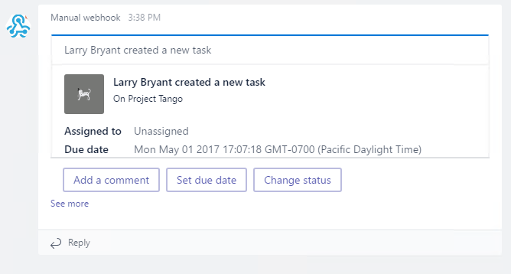
Integrating external systems using connectors / webhooks
Activity posted to Channel
Rendered as any other message
Text
Card
Actionable Card
POSTed to registered endpoint
Incoming Webhook
Teams provides URL, must be copied
Office 365 Connector
Automated flow for capturing URL
Requires registration and publication

Slide 4
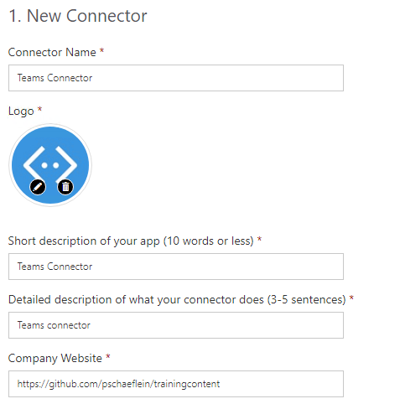
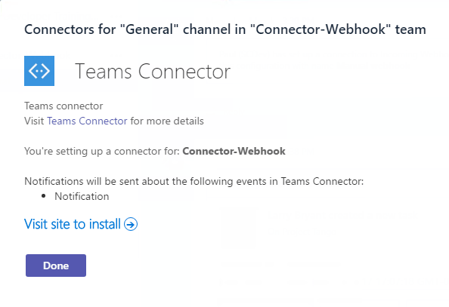
Connector - Manifest
connector node
Identifies registered connector via connectorId
Information provided during registration shown when adding to Channel
"connectors": [ { "connectorId": "[ConnectorAppId]", "scopes": [ "team" ] } ]
Notes:
connectors is part of the manifest.json file

Slide 5
Demo Connector / webhook
Notes:
This demo uses developer utilities to create a card via a webhook and shows the Connector registration pages.

Slide 6

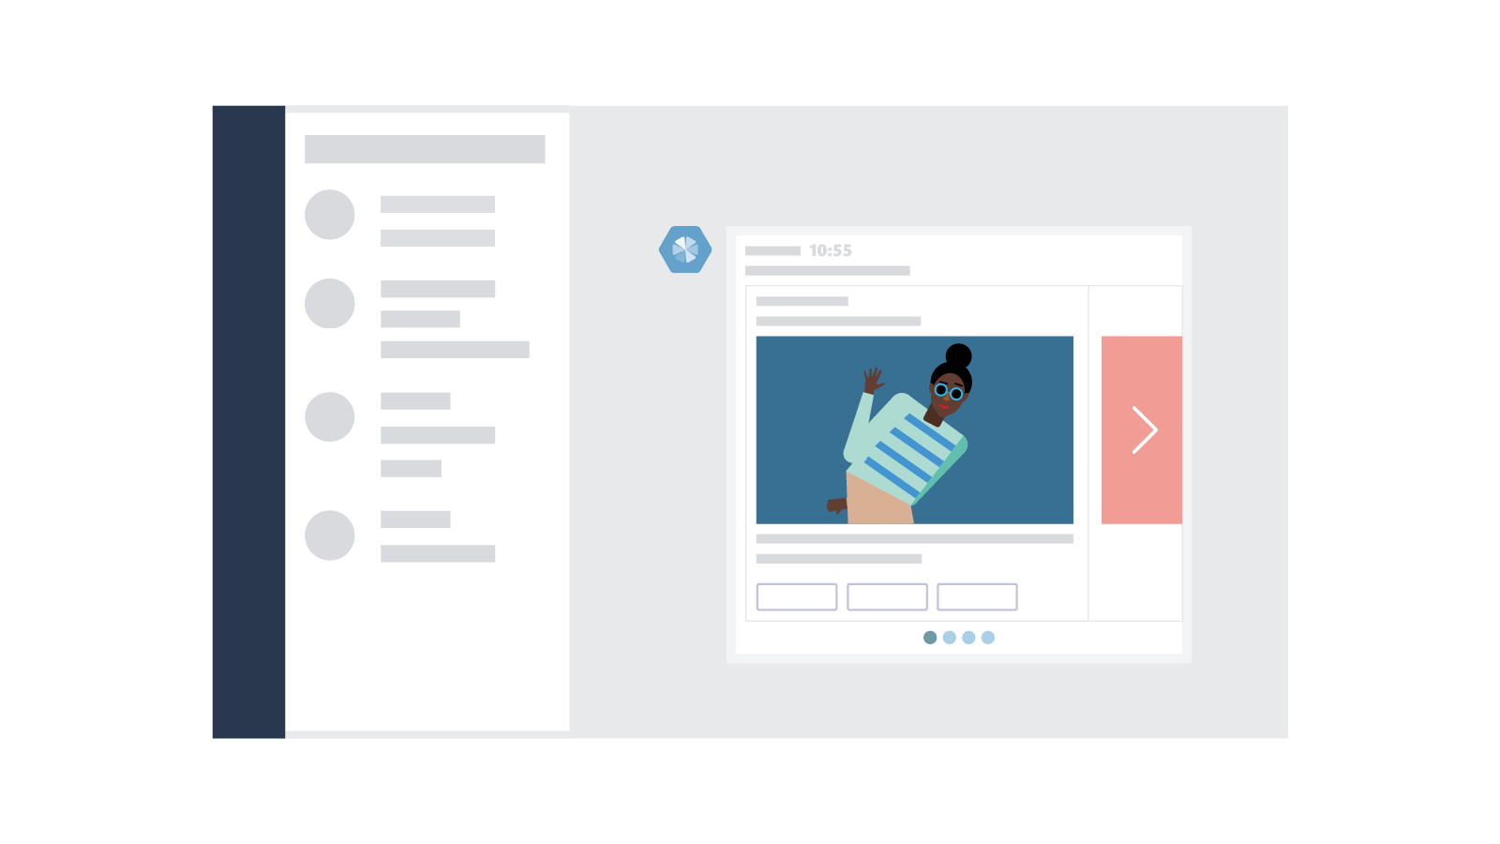

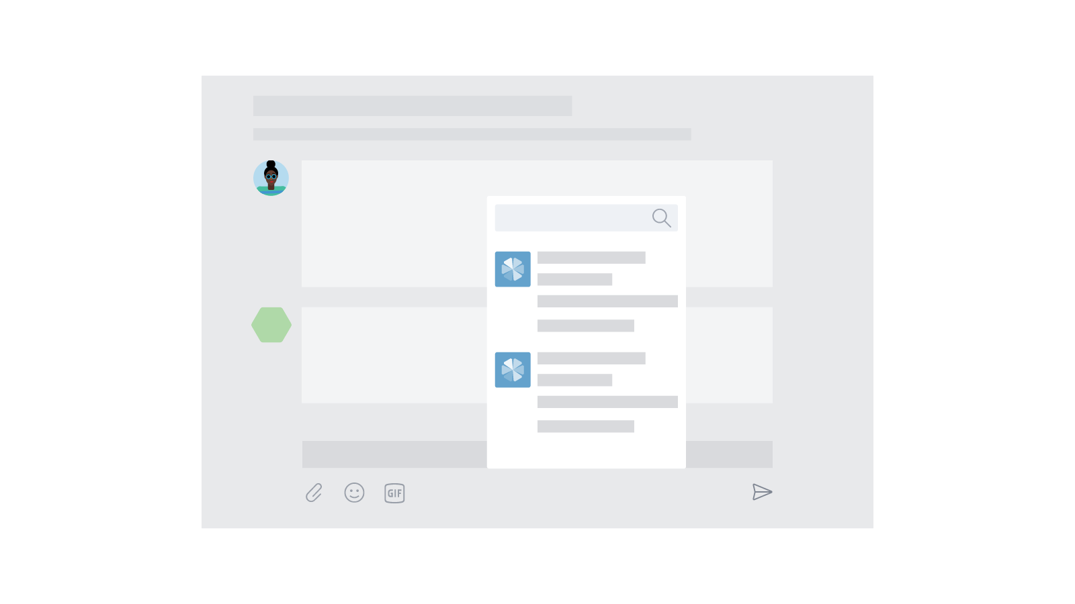
Teams App contains multiple capabilities
Tabs and conversations
Tabs give your app a dedicated canvas that allows people to jump between conversations and your experience.
Customizable cards
Cards let you surface important tasks, information, and reminders in actionable ways.
Bot framework
The Bot framework offers a natural language UX that can interact with your services.
Compose extensions
Compose Extensions are quick and easy shortcuts to key components f your service.
Notes:
This information comes from the Microsoft Teams Design Guidelines: http://msteamsdesignguidelines.azurewebsites.net/#!/
All of these capabilities are possible in an app, not in a custom bot.
Not all are required. Only publish those that make sense, or start with one and build out over time.

Slide 7
Multiple capabilities – Manifest
Top-level nodes
Use what you need
Single package
Same icons
Same names
Same descriptions
Easy deployment
{ "$schema": "https://statics.teams.microsoft.com/...",
"manifestVersion": "1.0",
...
"configurableTabs": [],
"staticTabs": [],
"bots": [],
"connectors": [],
"composeExtensions": []
}

Slide 8
Demo Multiple capabilities
Notes:
After adding the Connector to the existing bot, Sideload to a new team. Notice that the TeamMembersAdded event fires and the bot initiates a 1:1 conversation. And, the Connector shows in the sideload section of connector dialog.

Slide 9

Summary

Slide 10
Thank you

